Slide 1
Revision of Module 3
长海县獐子岛镇中心小学
石丹

Slide 2
Let’s talk about festivals with simple present tense(用一般现在时谈论节日)

Slide 3
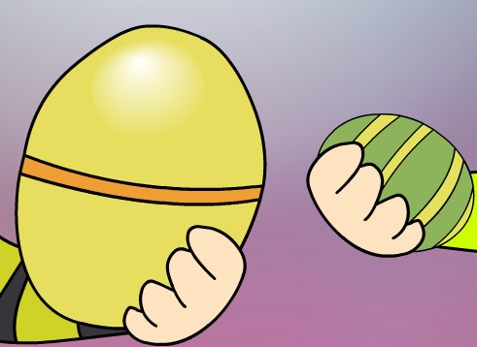
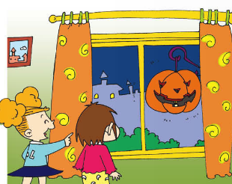
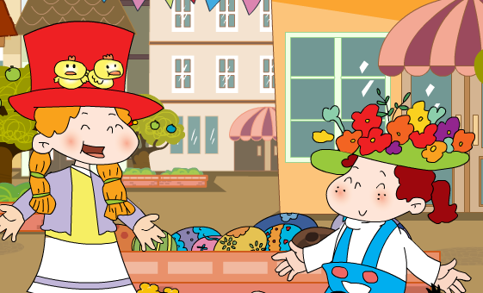
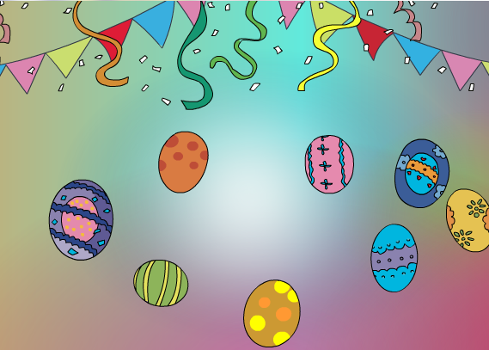
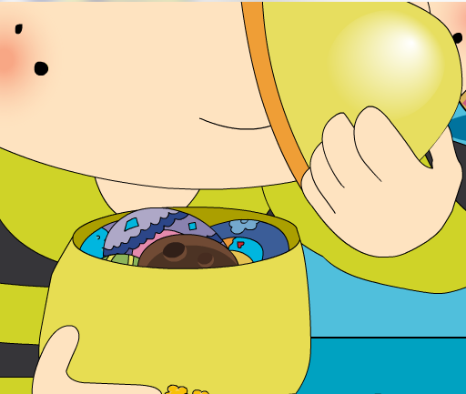
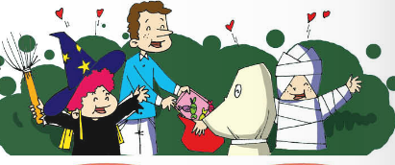
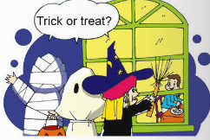
Look and divide(看一看分一分)

Slide 4
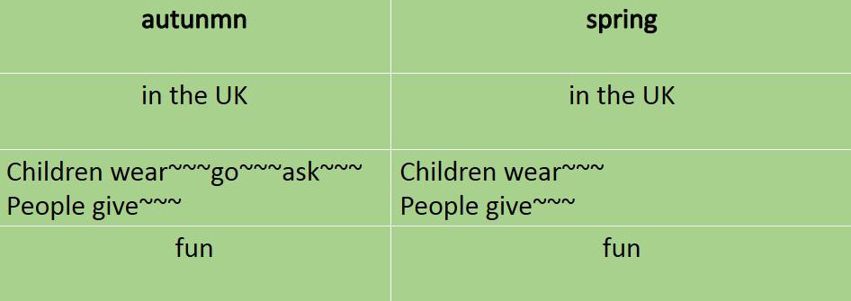
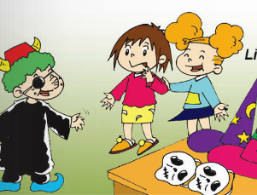
Think and complete
 | Halloween | Easter
When
Where
What
How

Slide 5
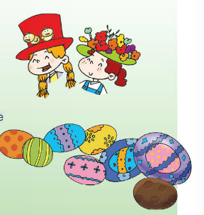
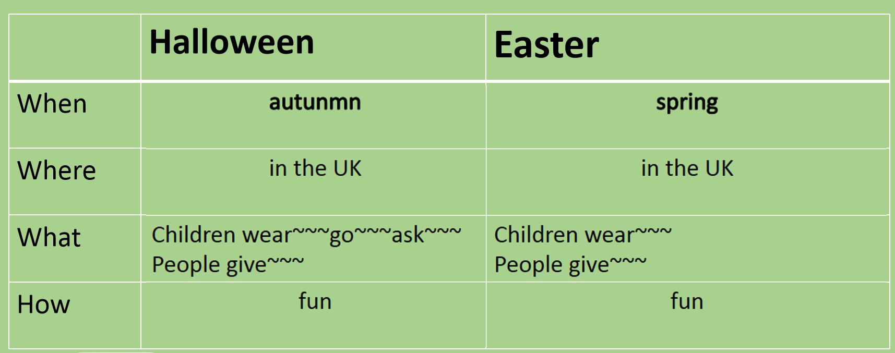
Think and say

Slide 6
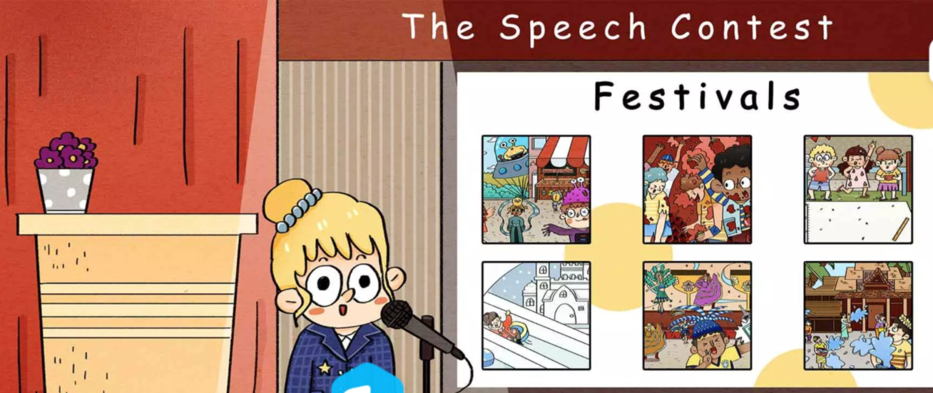
Watch and count
How many festivals are there in this video?
The Rosewell UFO Festival （罗斯威尔UFO节--美国）
The La Tomatina Festival(番茄狂欢节--西班牙)
The Watermelon Festival (西瓜节--澳大利亚)
The Sapporo Snow Festival （札幌冰雪节--日本）
The Brazil Carnival（巴西狂欢节）
The Water Splashing Festival of Dai people(傣族泼水节)

Slide 7
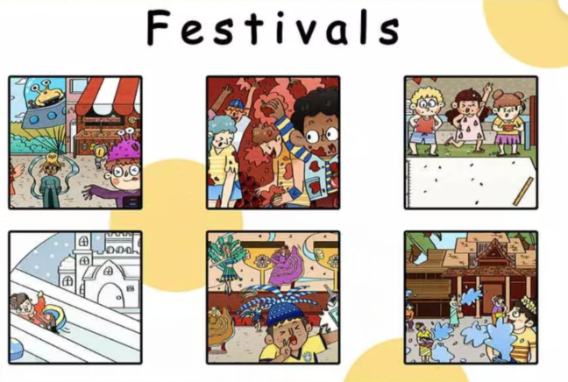
Look and choose
A. The Rosewell UFO Festival （罗斯威尔UFO节）is in July(7月).People walk on the streets with firends.They dress up as aliens（外星人）.
B. The Watermelon Festival is in February(2月).People spit out （吐出）watermenlon seeds（籽）. If someone spit the seed farthest（最远）,he or she will win.
A
C
B
C. The La Tomatina Festival(番茄狂欢节) is on the last Wednesday of August(8月).People go to the square（广场） with friends.They throw（扔） tomatoes at each other.
D
F
E
D. The Sapporo Snow Festival （札幌冰雪节）is in the first week of February.People go to Odori Park（大通公园） .They see the snow scuptures（雪雕） and play on a slide(滑梯) made of snow.
E. The Water Splashing Festival of Dai people(傣族泼水节) is in April. People go to the village and splash（泼水） water on each other.
F. The Brazil Carnival（巴西狂欢节） is in February.People wear special clothes in the main street. They watch singers and dancers in the Samba Parade(桑巴舞).

Slide 8
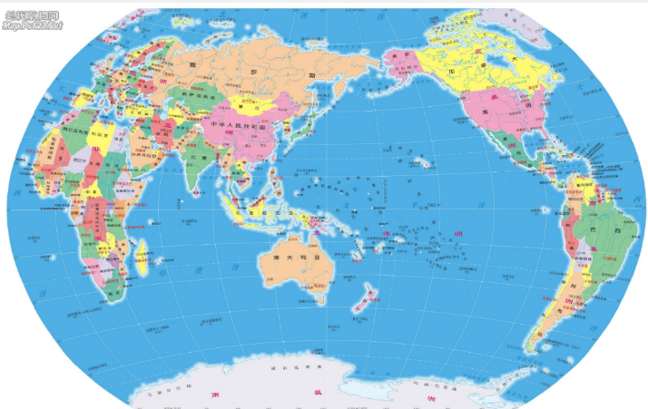
There is such a lot of world to see.
世界那么大，我想去看看

Slide 9
Chinese Festivals
Which festival do you hear about?
Chose your favourite festival and then share in class.
Why?(How?)

Slide 10
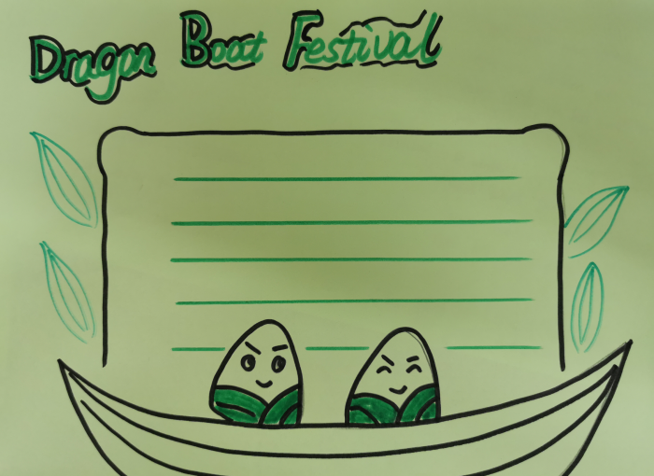
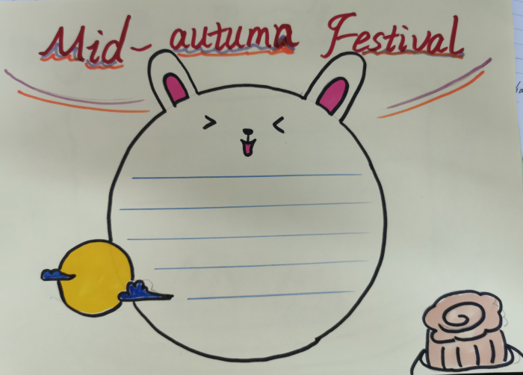
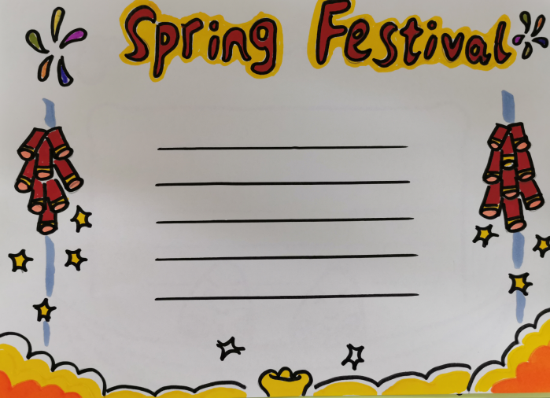
Let’s make a poster about Chinese festivals.

Slide 11
My favourite festival is_______in China. People__________.And they______.They have a good time.
________ festival is a /an_____festival in China. People usually__________and_______.Then ______.It’s really fun.
_________ festival is in _______in China. We __________.We______,too.What an interesting festival!

Slide 12
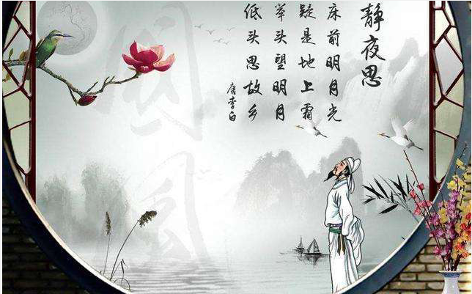
A Tranquil Night
Abed, I see a silver light,
I wonder if it's frost aground.
Looking up, I find the moon bright;
Bowing, in homesickness I'm drowned.

Slide 13
Learn young,learn fair. (为学趁年青，既学需学好) Never too old to learn. （活到老，学到老）

Slide 14
Homework
必做：
1.巩固单词短语功能句
2.整理节日思维导图
选做：
背诵默写小文

Slide 15
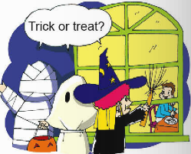
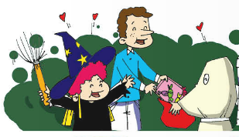
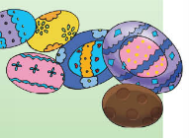
Test
1.Halloween is an autumn ________in the UK.
2.That _______(夜晚),children go to their ________houses and ask,”Trick or treat?” _____（然后）their neighbours________them sweets.
3.People give children _________eggs.

Slide 16
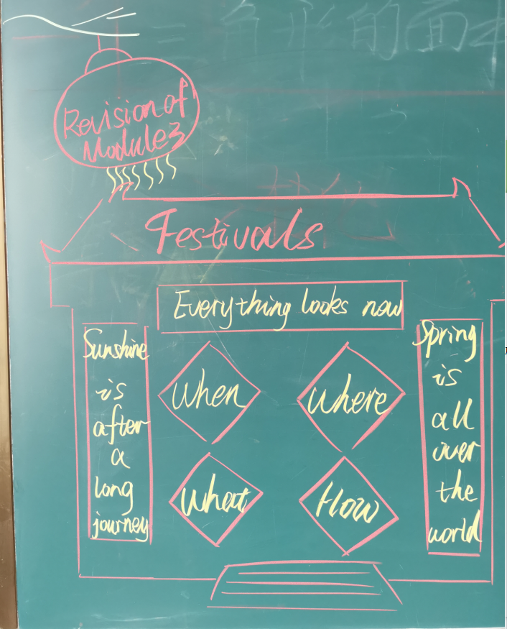
板书设计

