Slide 1
小学英语一年级下册教材思维导图汇编
海洋岛学校 英语组

Slide 2
任务分工：
M1-M4 （3-10）设计教师：杨静怡
M5-M7 （11-16）设计教师：王雪
M8-M10 （17-22） 设计教师：刘建丽

Slide 3
Module1 Unit1
He's
She's
a
doctor......
杨静怡

Slide 4
Module1 Unit2
He's
She's
I'm
a
nurse......
杨静怡

Slide 5
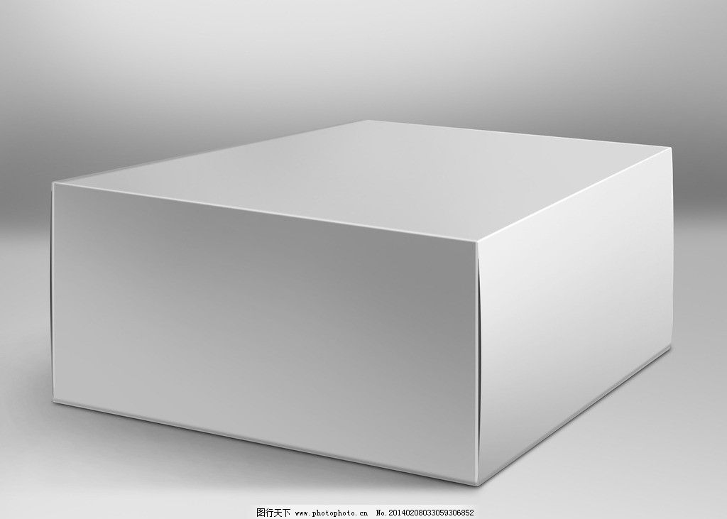
Module2Unit1
on
in
box
Where's the cat?
under
杨静怡

Slide 6
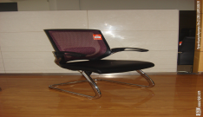
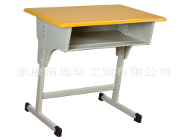
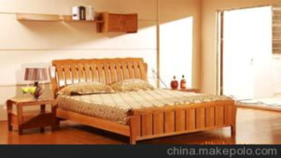
Module2Unit2
on
is
in
under
杨静怡

Slide 7
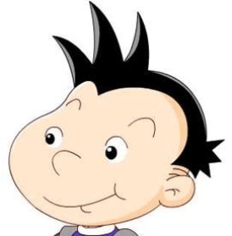
Module3Unit1
Where's the cat?
Is it under the bed?
I don't know.
Yes,it is.
杨静怡

Slide 8
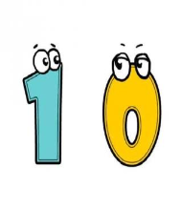
Module3Unit2
How many ?
杨静怡

Slide 9
Module4Unit1
This is your......
This is my......
杨静怡

Slide 10
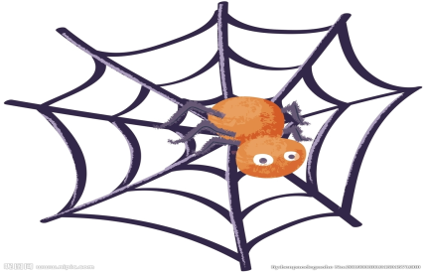
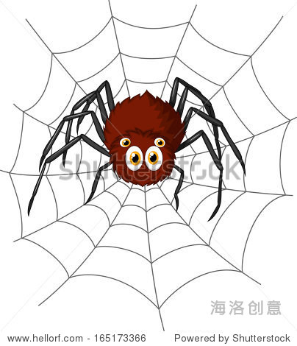
Module4Unit2
These are your......
杨静怡

Slide 19
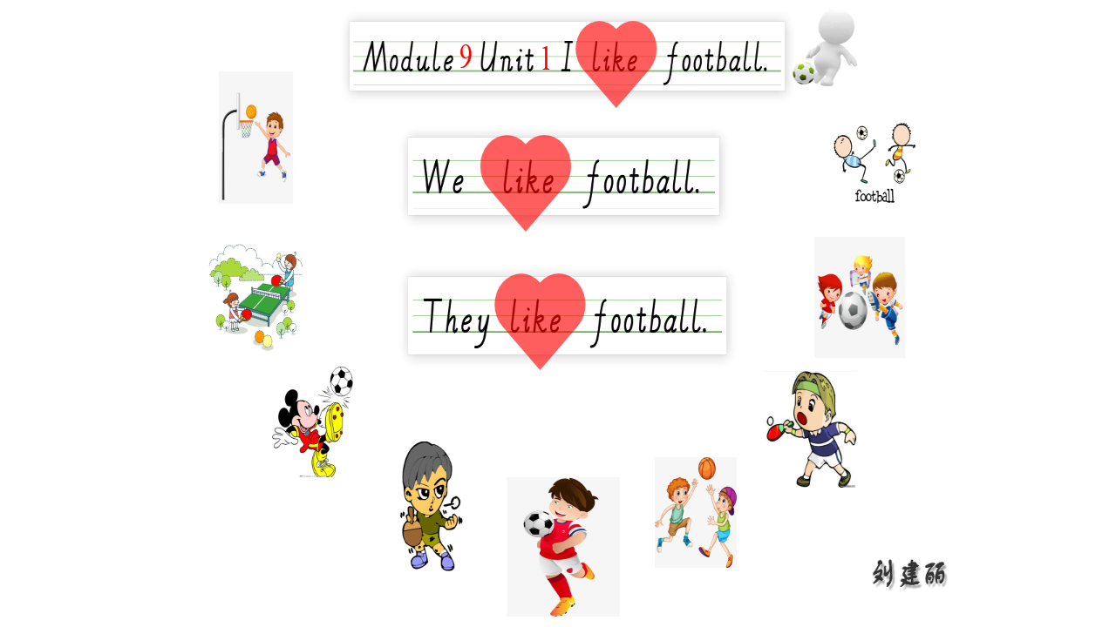

Slide 20
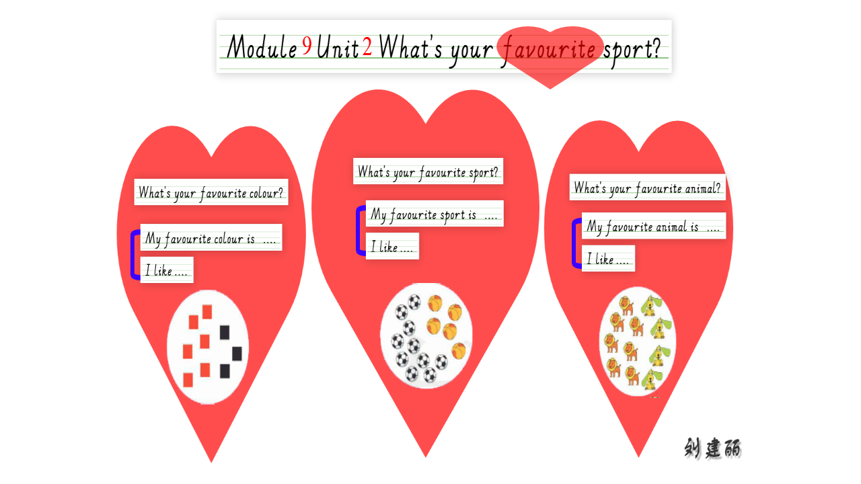

Slide 21
