Slide 1
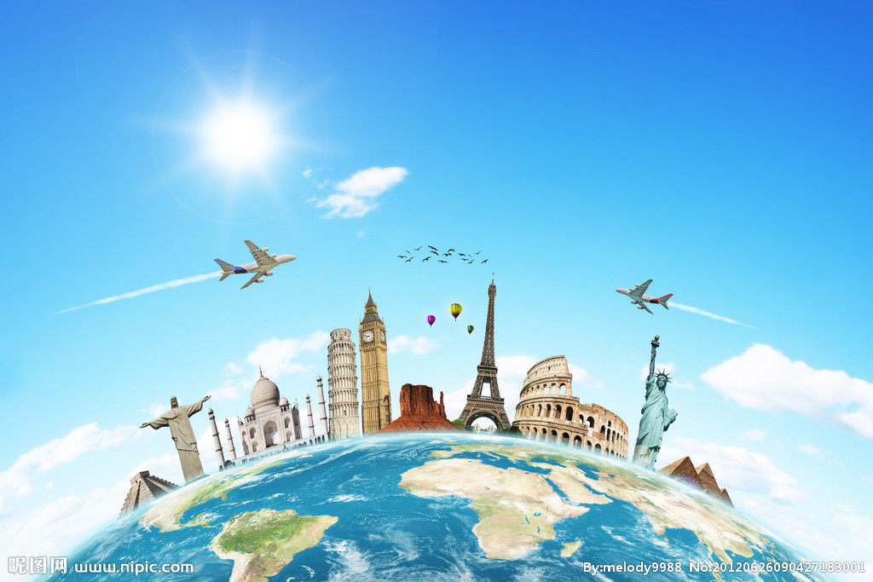
Revision of Module 1&9
小长山岛镇中心小学 王月

Slide 2
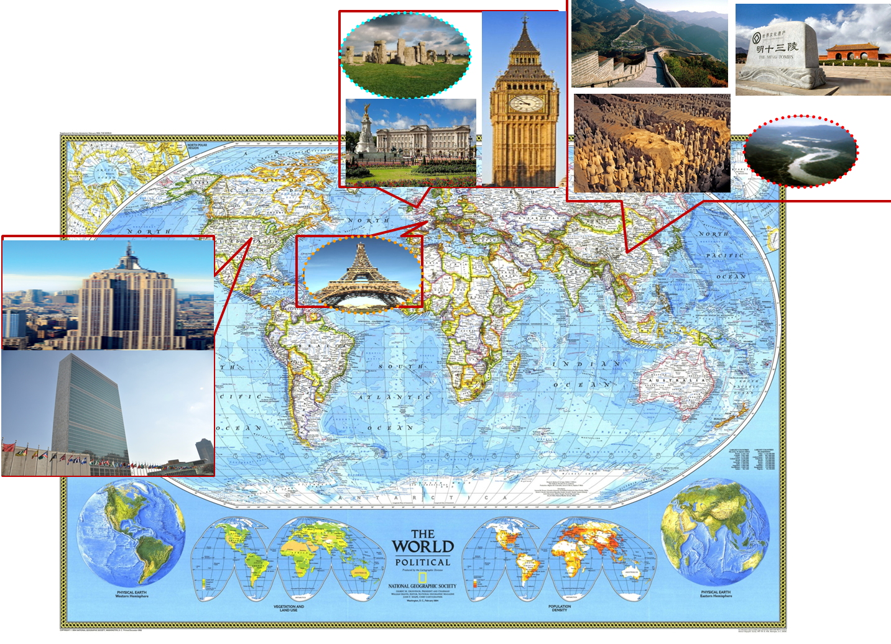
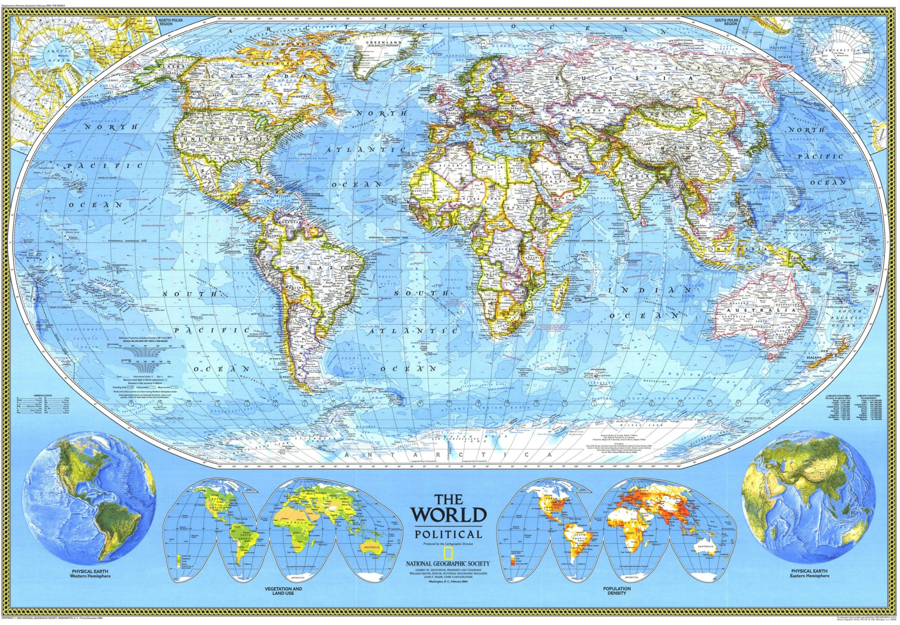
Do you want to visit …?

Slide 3
Task
Introduce your favourite place
做小导游,运用一般现在时介绍最喜欢的地方.
Notes:
After you learn this lesson, you will try to introduce you travel plan(贴主题）

Slide 4
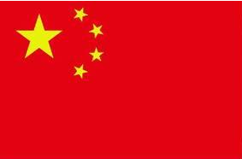
Read and fill in the blanks .
China is a beautiful and peaceful country . There are lots of famous places to go in China .
Beijing is the capital of China . It’s big and beautiful . It’s got a long history . There are many beautiful places in Beijing . For example , the Great Wall . It’s more than two thousand years old . It’s more than forty thousand li long . It’s too long . We can’t walk along all of it . There’s a saying : You are not a hero unless you climb on the Great Wall .
Shanghai is in the east of China . It’s a modern city . It’s big and famous . The City God Temple (城隍庙) is a famous place in Shanghai . People can buy something nice and cheap there .
Kuming and Guilin are beautiful places , too . They are in the south of China .Dianchi----- a beautiful lake , is in Kuming . And there are lots of mountains and lakes in Guilin . Guilin’s scenery is the best in the world .
There are also lots and lots of beautiful places to go in China .
Welcome to China .
 | The Great Wall | Shanghai | Kuming | Gulin
Where ?
How old ?
How long
What’s it like ?

Slide 5
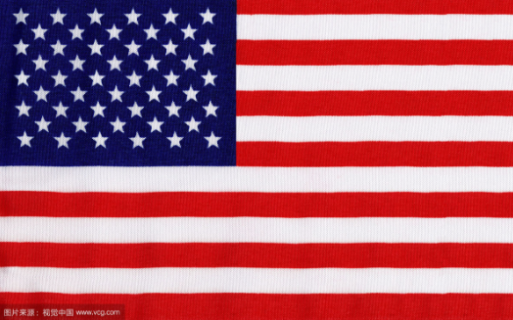
Read and complete .
First let’s go into a style building in New York , the Empire State Building .. It’s an o_______ b_______ . It’s ___________(超过)eighty years old . And it’s very high . It’s more than four hundred m______ high . It’s still the tallest skyscraper (摩天大楼)in the world .
Then let’s visit the UN building . It’s a very i___________ building in New York . It’s about 167 m_______ tall . The UN building was built in 1947 . The UN wants to ______________(维护和平) in the world . Many c_________ are in the UN . China is one of the 193 m_______ s________ in the UN . You can visit the UN building from Monday to Friday ---9:45am to 4:45pm . Tickets for young people are $12.5 .
Do you want to visit the Empire State Building and the UN building ?
ffice
uilding
more than
etres
mportant
etres
make peace
ountries
ember
tates

Slide 6
Read and do .
First let’s go into a style building in New York,the Empire State Building . It’s an office building . It’s more than eighty years old . And it’s very high . It’s more than four hundred metres high . It’s still the tallest skyscraper (摩天大楼)in the world .
Then let’s visit the UN building . It’s a very important building in New York . It’s about 167 metres tall . The UN building was built in 1947 . The UN wants to make peace in the world . Many countries are in the UN . China is one of the 193 member states in the UN . You can visit the UN building from Monday to Friday ---9:45am to 4:45pm . Tickets for young people are $12.5 .
Do you want to visit the Empire State Building and the UN building ?
阅读短文，判断正确T，错误F
( )1.The UN building is taller than the Empire State Building .
( )2.There are 193 member states in the UN .
( )3.The Empire State Building is an office building .
( )4.You can visit the UN building at nine o'clock on Monday .
5.How high is the Empire State Building ?
___________________________________
6.What does the UN want to do ?
___________________________________
F
T
T
F
Tips :
Underline the answer .
Circle “Wh-/ How”
It's more than four hundred metres high .
The UN wants to make peace in the world .

Slide 7
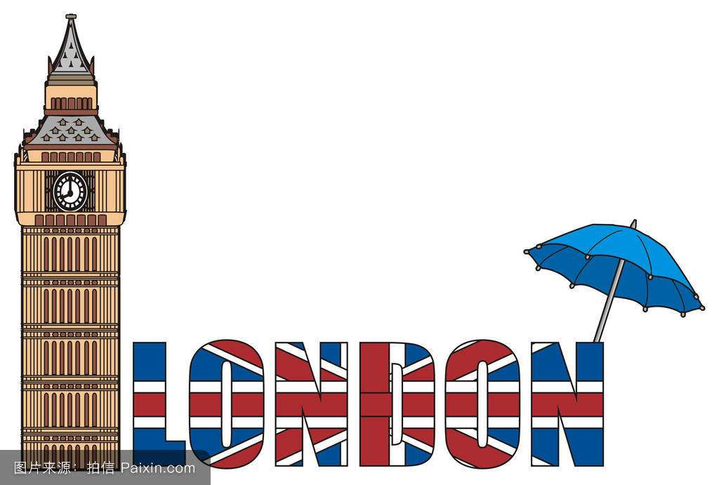
Read and answer .
Big Ben is one of the most important symbols in New York .It’s a Clock Tower . The tower holds the largest four-faced chiming clock in the world and is the third-tallest free-standing clock tower. The tower was completed in 1858 .It’s ninety-five metres high . And it rings every fifteen minutes .
The River Thames is the famous “mother river ” in England . It’s 402 kilometres long . Tower Bridge (built 1886-1894) is a combined bascule and suspension bridge in London, England, over the River Thames.
The London Eye is another symbol . It’s near the River Thames . It’s 135 metres high . It’s the first ferris wheel(摩天轮) in the world .
Tips :
Read and guess the unknown words according to the passage .
How high is Big Ben ?
______________________________
2.How long is the River Thames ?
_____________________________
3. How often does Big Ben ring ?
______________________________
4.Is Tower Bridge a tower ?
_______________________________
5.Is the London Eye the first ferris wheel in the world ?
_______________________________
It's ninety-five metres high .
It's 402 kilometres long .
It rings every fifteen minutes .
No , it isn't .
Yes , it is .

Slide 8
Guessing game
Read and guess :
What 's it ?
1. It’s in New York . There are lots of Chinese shops and restaurants . There is a lion dance in the street .People speak Chinese and English there .
2.There are lots of stone animals and a red gate . People found clothes and money in the tombs .
3.It’s in the south of China . There are coconut trees and the Five –Finger Mountain .
Read and judge(T / F) :
It’s a beautiful island in China . There are five big islands . The sea is clean and beautiful . You can fish and gather seafood (赶海) .The beach is soft and golden . You can play on the beach . There’s a bridge -----Changshan Bridge , across two islands . It’s more than one thousand seven hundred metres long .
That’s Hainan Island . ( )
1'
2'
3'
4'

Slide 9
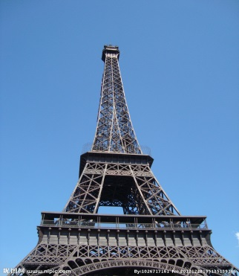
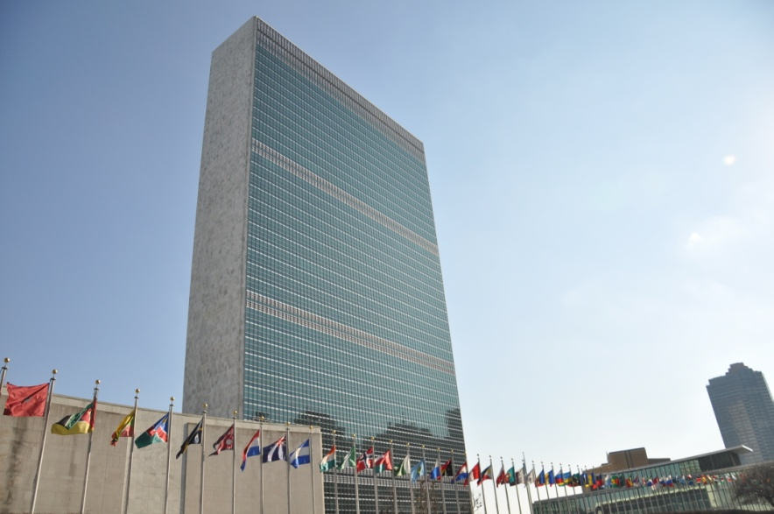
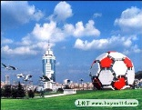
Introduce your favourite place
The Labor Park
Dalian, one of the biggest parks,
lots of animals,
a big football
…
The Great Wall
China, 2000 years old，
20000km long
…
TheEiffel Tower
France, 324m high,
restaurants
…
The UN building
New York ,
make peace in the world
…
The Empire State Building
the US,
80 years old ,
400m high
…
A: The winter holiday is coming .
Where do you want to visit ?
B: I want to visit ___________.
A: Where is it ?
B: It’s in _______.
(A: How old / high / long is it ?
B: It’s ___________________.)
A: Can you tell me more about it ?
B: Sure ._____________.

Slide 10
“Little guide ” Introduce the place
The Labor Park
Dalian, one of the biggest parks,
lots of animals,
a big football
…
The Great Wall
China, 2000 years old，
20000km long
…
The Eiffel Tower
France, 324m high,
restaurants
…
The UN building
the US,
make peace in the world
…
The Empire State Building
the US,
80 years old ,
400m high
…
Welcome to __________.
This is ______________.
It’s___________________. It’s ______________.
____________________________________.
____________________________________.
____________________________________.
Do you want to visit it ?

Slide 11
Civilization Tourism
（文明旅行）

Slide 12
Homework
必做:
背写核心词、功能句，背诵课文。
完善小练笔，并与同学分享。
尝试小组一起制作景点宣传册.
选做：
为你喜欢的地方设计警示牌，温馨提示。

